Slide 1
CAPTURING REQUIREMENTS
Mehwish Mumtaz

Slide 2
The hardest single part of building a software system is deciding what to build.
Fred Brooks

Slide 3
Requirements
A requirement is an expression of desired behaviour
Requirements focus on the customer needs, not on the solution or implementation

Slide 4
A Systems Approach (Contd.)
Objects
i.e. things
Activities
Actions taken
Input / Outputs
Relationships for example:
Which object performs what activities
Which objects are associated with other objects
System Boundary
Who generates input and who receives output
Which objects/activities are part of the system and which are not
Nested systems, related systems, interrelated systems

Slide 5
We need a time series model for the purpose of forecasting demand
Why projects fail
One reason incomplete requirements
Requirement gathering tasks- Requirement Analyst/System Analyst
Important Note:

Slide 6
Inception
Identify: all stakeholders, measurable benefits of successful implementation, possible alternatives
Ask questions stepwise, as early as possible, first meeting/encounter
Possible questions at 1st step (stakeholders, overall goals and benefits):
Who is behind the request for this work?
Who will use this solution?
What will be the economic benefit of a successful solution?
Goods Retailer with physical shops;
Food retailer
E-commerce retailer
Wholesaler (any)

Slide 7
Inception
Possible questions at 2nd step (detailed understanding and customer perception about the solution):
What problems(s) will this solution address?
Can you show me (or describe) the business environment in which the solution will be used?
How do you characterize the ‘good’ output?
Possible questions at 3rd step (effectiveness of communication):
Are you the right person to answer these questions?
Are my questions relevant to the problem that you have?
Can anyone else provide additional information?

Slide 8
Requirements Elicitation
Get more detailed requirements
Problem Customer knows their business but do not good at describing the business
Developer problem ?jargons, different words have different meaning

Slide 9
Requirements Elicitation
Customers do not always understand what their needs and problems are
It is important to discuss the requirements with everyone who has a stake in the system
Come up with agreement on what the requirements are
If we cannot agree on what the requirements are, then the project is doomed to fail

Slide 10
Requirements Elicitation
Different Stakeholders are:
Clients: pay for the software to be developed
Customers=User: buy the software after it is developed
Users: use the system
Domain experts: familiar with the problem that the software must automate example Consulting Banker for bank system
Market Researchers: conduct surveys to determine future trends and potential customers
Lawyers or auditors: familiar with government, safety, or legal requirements
Software engineers or other technology experts

Slide 11
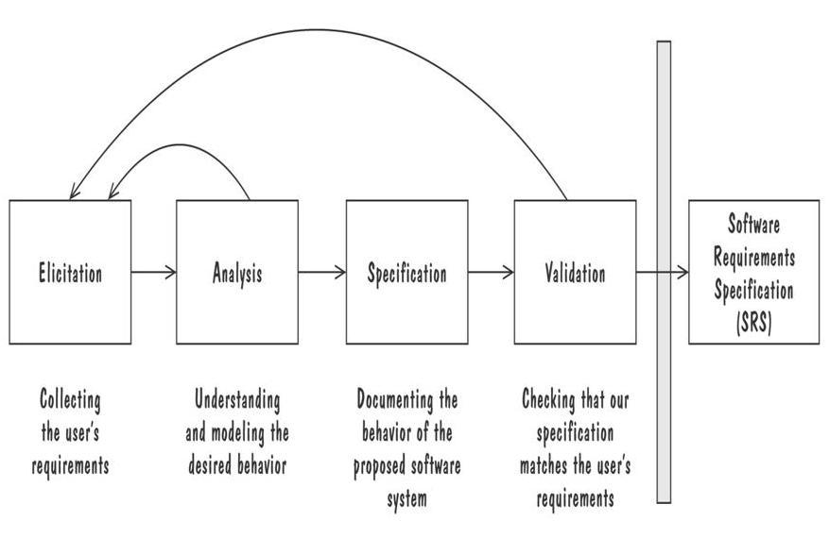
Requirements Elicitation
To designers testers and developers
Process for Capturing Requirements
Asking Questions/Study
Similar Systems
Prototype
How to implement the solution
Matches customer
Expectations

Slide 12
Requirements Elicitation
Conflict of Requirements
Example: Three modes of a software
Requirement Analyst?
Analysis Skills

Slide 13
Requirements Elicitation

Slide 14
Elaboration
Analyze, model, specify…
Some Analysis Techniques
Data Flow Diagrams (DFD)
Use case Diagram
Object Models (ER Diagrams, Abstract class diagrams)
Decision Tables
State Diagrams (State charts)
Fence Diagrams
Event Tables
Petri Nets
Event Traces (Message Sequence Charts)
Flow-oriented, Scenario-based, Class-based, Behavioral

Slide 15
Data Flow Diagrams (DFDs)
A data-flow diagram (DFD) models functionality and the flow of data from one function to another
A bubble represents a process (or data transform)
A labelled arrow represents data flow, the label describes the data being transferred
A data store: a formal repository or database of information
Rectangles represent Information source/sink: entities that provide input data or receive the output result
Heritage identifier: to document stepwise refinement

Slide 16
Creating Data Flow Diagrams
Steps:
Create a list of activities
Construct Context Level DFD (identifies external entities and processes)
Construct Level 0 DFD (identifies manageable sub process )
Construct Level 1- n DFD (identifies actual data flows and data stores )
Check against rules of DFD

Slide 17
DFD Naming Guidelines
External Entity → Noun
Data Flow → Names of data
Process → verb phrase
a system name
a subsystem name
Data Store → Noun

Slide 18
Requirements of attendance Management System
Admin can manager users and view reports
Principal can view college reports
Teacher mark attendance and view attendance
Head allocate departments and view department report

Slide 19
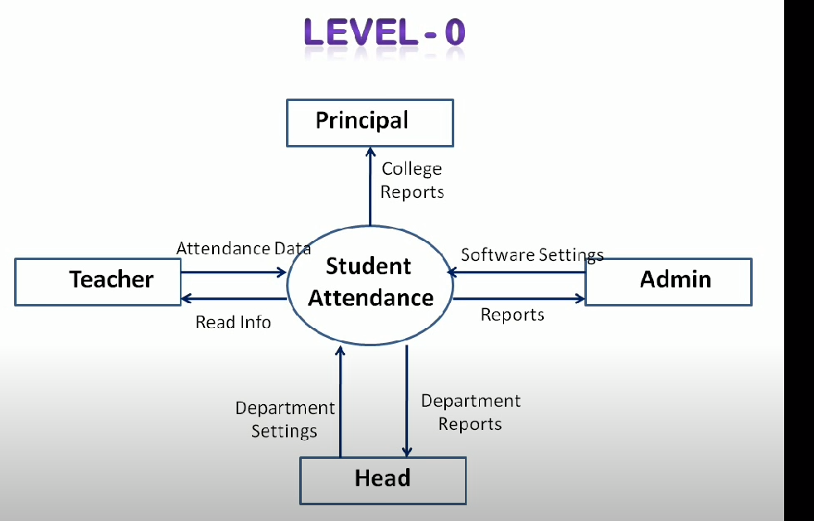
Level 0 DFD-Contextual Diagram

Slide 20
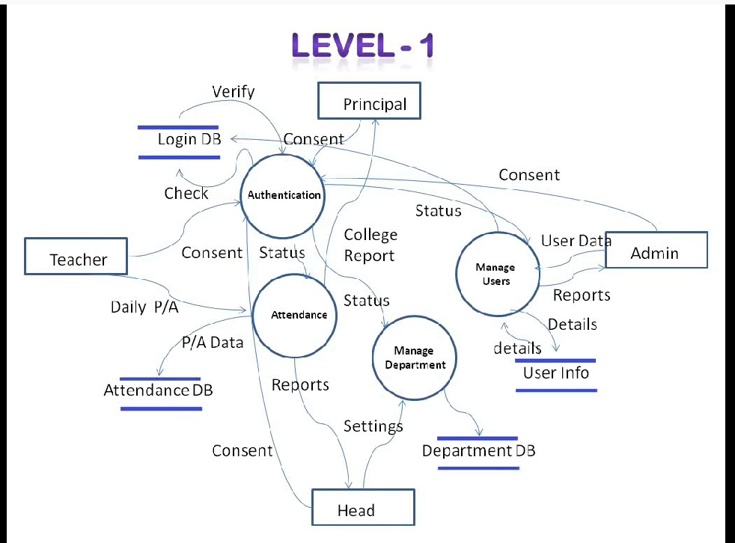
Level 0 DFD-Contextual Diagram

Slide 21
Data Flow Diagrams (Contd.)
Advantage:
Provides an intuitive model of a proposed system's high-level functionality and of the data dependencies among various processes
Disadvantage:
Can be aggravatingly ambiguous to a software developer who is less familiar with the problem being modelled

Slide 22
Checking Consistency of DFDs
The following checklist can be used to verify the consistency of a collection of DFDs:
Is each requirements function represented by a data transform somewhere in the DFDs?
Is each system input and output represented in the DFDs?
Is each input and output from higher-level DFDs reproduced correctly in any lower-level refinement DFDs?
Is each transform in the lowest-level DFDs is a primitive one?

Slide 23
Checking Consistency of DFDs (Contd.)
The following checklist can be used to verify the consistency of a collection of DFDs (contd.):
Do all information flows have labels that correspond to an entry in the data dictionary?
Do all data dictionary entries appear in some DFD?

